Slide 1
CHE 0426
Introduction to Optimization
Engr. Rommel N. Galvan

Slide 2
Why optimized?
Improve the process to realize maximum system potential;
Attain improved designs; maximize profits; reduce cost of productions.

Slide 3
Essential features of optimization problem
An objective function is defined which needs to be either maximized or minimized. The objective function may be technical or economic. Examples of economic objective are profits, costs of production etc.. Technical objective may be the yield from the reactor that needs to be maximized, minimum size of an equipment etc.. Technical objectives are ultimately related to economics.
Underdetermined system: If all the design variables are fixed. There is no optimization. Thus one or more variables is relaxed and the system becomes an underdetermined system which has at least in principle infinite number of solutions.

Slide 4
Essential features of optimization problem- Continued
Competing influences: In most of the optimization problems, there would be some set of variables which has opposite influence on the objective function. Such competing influences require some balancing and hence result in typical optimization problems.
Restrictions: Usually, the optimization is done keeping certain restrictions or constraints. Thus, the amount of row material may be fixed or there may be other design restrictions. Hence in most problems the absolute minimum or maximum is not needed but a restricted optimum i.e. the best possible in the given condition

Slide 5
Problem Statements
Given a design vector
An objective function f(x)
A set of equality constraints g(x)=0
A set of inequality constraints, h(x)≥ 0
The general problem formulation:

Slide 6
Examples- An Inspector Problem (Linear Programming):
Assume that it is desired to hire some inspectors for monitoring a production line. A total amount of 1800 species of products are manufactured every day (8 working hours), while two grades of inspectors can be found. Maximum, 8 grade A inspector and 10 grade B inspector are available from the job market. Grade A inspectors can check 25 species/hour, with an accuracy of 98 percent. Grade B inspectors can check 15 species/hour, with an accuracy of 95 percent. The wage of a grade A inspector is $4.00/hour, and the wage of a grade B inspector is $3.00/hour. What is the optimum policy for hiring the inspectors?

Slide 7
Problem Formulation
Assume that the x₁ grade A inspectors, x₂ grade B inspects are hired, then
total cost to be minimized
4(8)x₁ +3(8)x₂ +25(8)(0.02)(2)x₁ +15(8)(0.05)(2) x₂
=40 x₁ +36 x₂
manufacturing constraint
25(8) x₁ +15(8) x₂ ≥ 1,800 → 200 x₁ +120 x₂ ≥ 1,800
no. of inspectors available:
0 ≤ x₁ ≤ 8
0 ≤ x₂ ≤ 10

Slide 8
The Graphical Solution

Slide 9
Example – optimal pipe diameter
In a chemical plant, the cost of pipes, their fittings, and pumping are important investment cost. Consider a design of a pipeline L feet long that should carry fluid at the rate of Q gpm. The selection of economic pipe diameter D(in.) is based on minimizing the annual cost of pipe, pump, and pumping. Suppose the annual cost of a pipeline with a standard carbon steel pipe and a motor-driven centrifugal pump can be expressed as:
Formulate the appropriate single-variable optimization problem for designing a pipe of length 1000ft with a fluid rate of 20gpm. The diameter of the pipe should be between 0.25 to 6 in.

Slide 10
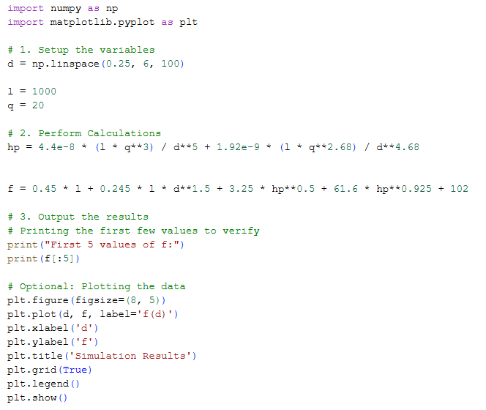
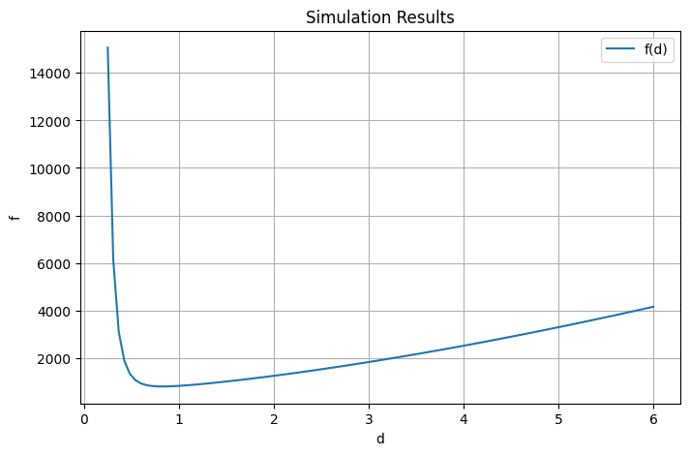
Python Code
https://colab.research.google.com/drive/1YcFnrEFjGIefFn9C8MHTS7PWEMMql11g?usp=sharing

Slide 11
Example - A Chemical Reactor Design Problem
Material Balances:
Energy Balances:

Slide 12
Example - A Chemical Reactor Design Problem
Problem: Assume that C₀, T_{J}, t_{f} can be designed, it is our objective to find good settings such that C_{B}(t_{f}) can be maximized

Slide 13
Special Types of Optimization problems
Unconstrained optimization
                In here, neither equality nor inequality constraint exists
Linear Programming (LP)
        In here, all the objective function and constraints are linear functions to x

Slide 14
Special Types of Optimization problems
Quadratic Programming (QP)
In here, only the objective function is quadratic,
but the constraints are linear

Slide 15
Special Types of Optimization problems
Optimization with respect to a continuous variable (Calculus of Variation)
Find x(t) such that
is minimized

Slide 16
Special Types of Optimization problems
Dynamic Programming (DP)
Here, x_{i} represents the state of the system in the ith stage and u_{i} is some decision variable, i.e. some decision taken at the ith stage. The values of x_{i} and u_{i} determine uniquely x_{i+1}:
Here, it is assumed that x0 is known, when the state of the system changes from xi to xi+1, there is an improvement or degradation in an objective function as cost or profit. Let this be J=f(x_{i},u_{i},i) , then the cumulative profit over N stages is:

Slide 17
Special Types of Optimization problems
As x₀ is fixed the magnitude of the cumulative profit is determined only by the various decisions taken u_{i} (i=0 to N-1). Hence Jc is to be optimized with respect to u_{i}.
Now, constraints may be imposed on x_{i} and u_{i}. This constitutes a dynamic programming (DP)

Slide 18
Special Types of Optimization problems
Integer Programming (IP):
Some of the variables are constrained to take integer values

Slide 19
The Iterative Optimization Procedure –
A Basic Idea
Optimization is basically performed in a fashion of iterative optimization. We give an initial point x0, and a direction s, and then perform the following line search:
where α* is the optimal point for the objective function and satisfies all the constraints. Then we start from x1 and find the other direction s’, and perform a new line search until the optimum is reached.

Slide 20
Terminology
Contour Plot

Slide 21
Terminology - Continued
Global optimum v.s. Local optimum

Slide 22
Terminology - Continued
Convex v.s. Concave functions
        A function φ(x) is called convex over the domain R if for all x1, x2∈R, and 0<θ<1, then
        If the inequality holds, the function is called strictly convex. A concave function is a function that cannot have a value smaller than that obtained by a linear approximation.

Slide 23
Terminology - Continued
Unimodal function
        If the function increases up to a maximum then decreases for all other values, it is called a unimodal function
Gradient and Hessian of a function
        Gradient of a function f(x) is defined by a column vector of the first partial derivatives of f(x) with respect to each variables x1 to xn evaluated at some x
        Hessian matrix of f(x) is defined as the symmetric square matrix of second partial derivatives

Slide 24
Terminology - Continued
Feasible Regions-
        Region of search.
        The region bounded by the inequality and equality constraints.
Convex region of search (not convex function):
        A convex region is one region such that a line joining any two points lying in the region.

Slide 25
Thank you

